Slide 1
HomeSpy
Team 13
web crawler + search engine + chat robot
Zhendong Wang(ZHW65), Yuhan Wang(YUW75), Hongyuan Cui( HOC27)

Slide 2
Agenda
The basic idea
The architecture
A short demo
Future works

Slide 3
Current Issue
We need a unified place to find house information
We need more powerful house search
The current search method is repetitive and tedious

Slide 4
Unified house Information
House information is spread in different places. E.g.
each apartment website has their own information,
house owner tends to post their house information on website like craigslist
Individuals also tend to post house rent information on Wechat/Facebook group.
We use web cralwer to fetch data from different website and directly build our product on currently very hot communication tool Slack!

Slide 5
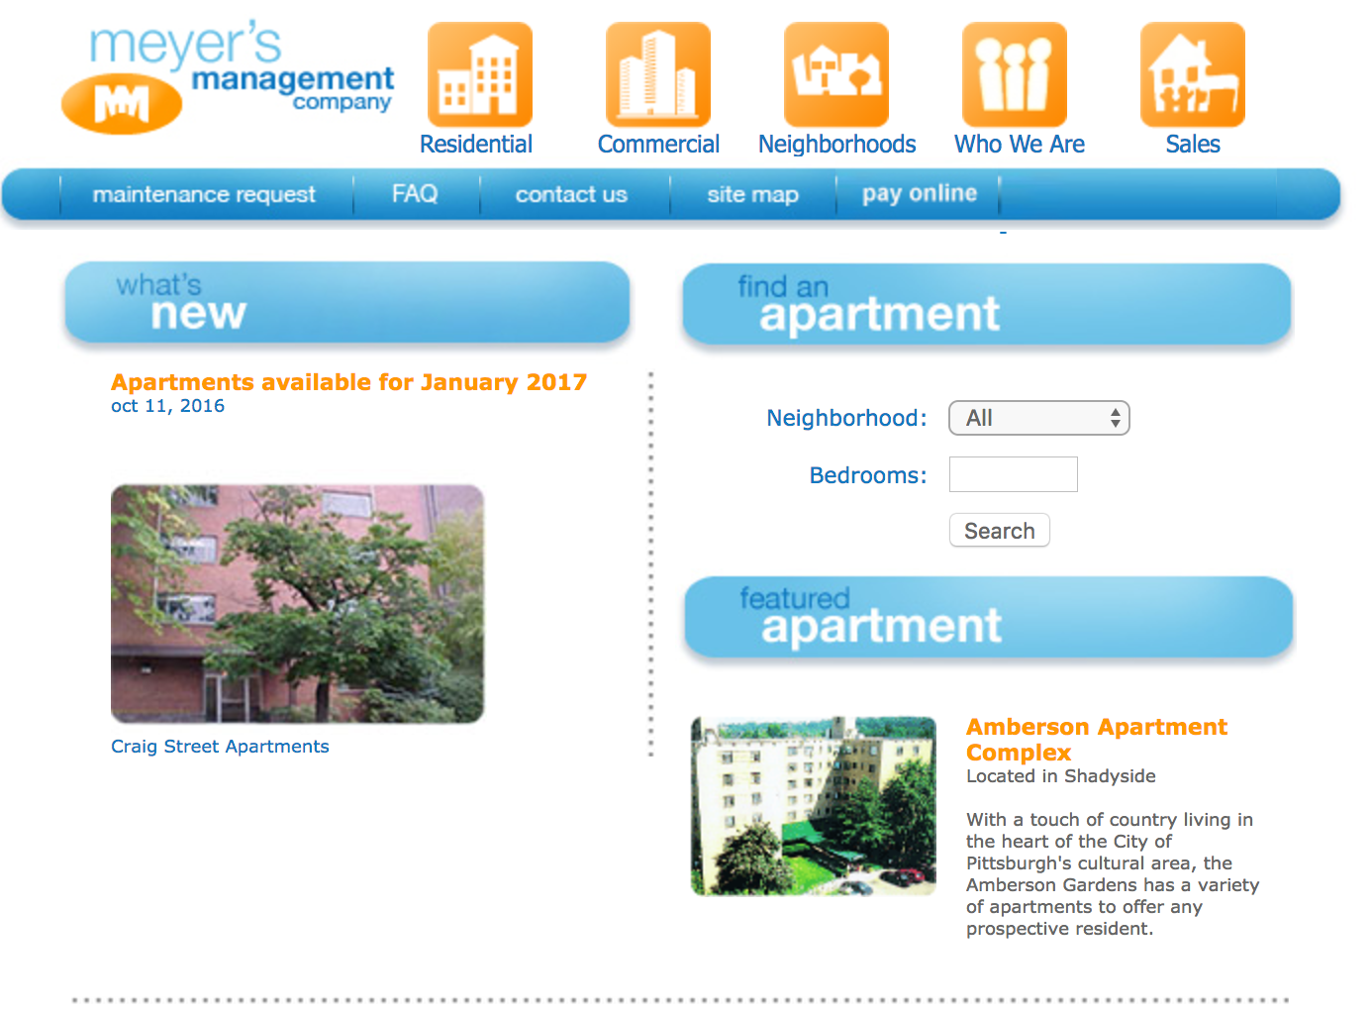
Better search
Current house search is not powerful…
Some website just don’t support much search criteria
Most website have the detail information like pet policy, whether the apartment has elevator, but they are usually hard to find.
Better data preprocessing to give you more search options, Fulltext search + highlight to help find the detail information you want. Intelligent query pre-processing to help you type less

Slide 6
Bot make life easier
Sometime when you go to a house search website, you don’t where to start…
Every search is done manually…
A chat robot will guide you step by step and try to do things intelligently (auto skip the house you already viewed in a new search, auto tell you new house source fit your needs when they are posted)

Slide 7
Our solution
A chat robot to guide your house finding easily

Slide 8
Architecture
4. use Botkit to write chat robot’s logic
1. collect data from different website
6. chat in slash!
2. clean the data
3. load data into elastic search to do index
5. setup the backend server to host the chat robot

Slide 9
A short demo

Slide 10
Future works
Index the people post house information
Index person information, so you can search room mate also
More intelligent functions like integrating the Google geo API to provide place information

Slide 11
Thank you

